Slide 1
PREDICTING EMPLOYEE ATTRITION: A HUMAN RESOURCES SOLUTION
BY LEONID SHPANER, PAYAL B MUNI, AND SEAN TORRES

Slide 2

PROBLEM (BACKGROUND/CURRENT SITUATION)
The Multinational Corporation wants to examine their employee attrition rate
Goal: To predict the likelihood of someone leaving the organization

Slide 3
PROBLEM (BACKGROUND/CURRENT SITUATION)
 | Stayed | Left | # of Employees | % Attrition
Department
IT | 954 | 273 | 1,227 | 22
RandD | 666 | 121 | 787 | 15
accounting | 563 | 204 | 767 | 27
hr | 524 | 215 | 739 | 29
management | 539 | 91 | 630 | 14
marketing | 655 | 203 | 858 | 24
product_mng | 704 | 198 | 902 | 22
sales | 3,126 | 1,014 | 4,140 | 24
support | 1,674 | 555 | 2,229 | 25
technical | 2,023 | 697 | 2,720 | 26
Total | 11,428 | 3,571 | 14,999 | 24
Current overall attrition amongst employee data: 24%
Notes:
14,999 rows of employee data
Many factors to determine employee attrition
Holistic factors
The HR department had the highest attrition rate;
accounting the second highest
Current overall attrition amongst employee data: 24%

Slide 4
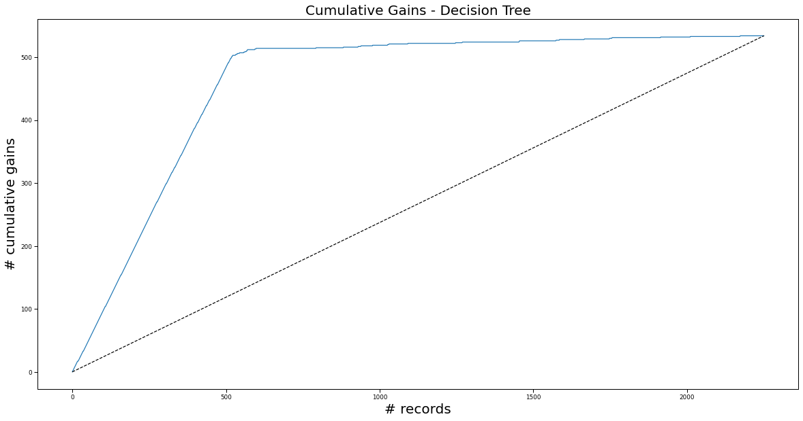

SOLUTIONS THAT WERE EXPLORED
Designed multiple models to see which predicts employee attrition the most accurately
Recommended Model: Decision Tree
Satisfaction (low or high)
Leave
Stay

Slide 5

RESULTS
That 24.3% people are likely to leave the company
Satisfaction Level had the highest impact in the Decision Tree model

Slide 6
RECOMMENDATIONS/ACTIONS
463 employees have less than or equal to 79% satisfaction
Data should be provided for us to perform future forecasts
Plan to fill the roles of employees that are likely to leave (knowing that attrition is predicted to be at a 24.3% rate)

